Slide 1
Application of the Adverse Outcome Pathway Framework:
Advances and Challenges
Daniel L. Villeneuve
US EPA* Mid-Continent Ecology Division, Duluth, MN, USA
*The contents of this presentation neither constitute nor necessarily reflect US EPA policy. Mention of trade names or commercial products does not indicate endorsement or recommendation for use.

Slide 2

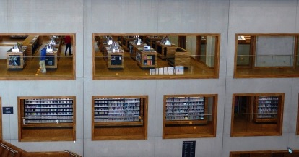
21st Century Toxicity Testing
We can rapidly and cost effectively generate pathway-based data
Activity of 1000s of chemicals in 100s of pathways
Wealth of basic biology and mechanistic toxicology studies in the extant literature
Scientific challenge of the 21st C….
How do we make effective use of those data and our wealth of existing scientific knowledge to support regulatory decision-making?
AOPs are part of the solution.

Slide 3
An Adverse Outcome Pathway (AOP) is a conceptual framework that portrays existing knowledge concerning the linkage between a direct molecular initiating event and an adverse outcome, at a level of biological organization relevant to risk assessment.
(Ankley et al. 2010, Environ. Toxicol. Chem., 29(3): 730-741.)
Macro-Molecular
Interactions
Cellular
Responses
Organ
Responses
Organism
Responses
Population
Responses
Toxicant
Chemical
Properties
Receptor/Ligand
Interaction
DNA Binding
Protein Oxidation
Gene activation
Protein production
Altered signaling
Altered physiology
Disrupted homeostasis
Altered tissue development/ function
Lethality
Impaired
Development
Impaired
Reproduction
Structure
Recruitment
Extinction
Helps us organize what we know
And utilize that knowledge to support risk-based decision-making

Slide 4
Outline
Advances in the AOP framework since January, 2014
    Core principles of AOP development
    Public release of AOP-Knowledgebase
Challenges to application of AOP framework for risk assessment and regulation

Slide 5
Principles of AOP Development
1. AOPs are not chemical-specific
Not trying to describe what a single chemical does
Trying to describe what ANY chemical that perturbs the MIE with sufficient potency and duration is likely to do- Biological motifs of failure
Describing AOP does not require chemical-specific information.
  Applying those motifs in a predictive context requires understanding chemical-specific properties (e.g., potency, ADME) that dictate the magnitude and duration of perturbation at the MIE.
Chlorpyrifos
AChE inhibition
Aceytocholine in synapses, accumulation
Ataxia, paralysis, induced
Respiratory distress, increased
Mortality, increased
Diazinon
Fenthion
Parathion
Malthion
Aldicarb
Carbaryl
Propoxur
Methomyl
Volz et al. 2011. Toxicol. Sci. 123: 349-358
Russom et al. 2014. Environ. Toxicol. Chem. 33: 2157-2169
………..

Slide 6
Principles of AOP Development
2. AOPs are Modular
Two Primary Building Blocks
Key Events (KEs)
Functional unit of observation/verification
Observable ∆ biological state (measurable)
Essential (but not necessarily sufficient)
Description
Methods for observing/measuring
Taxonomic applicability

Slide 7
Principles of AOP Development
2. AOPs are Modular
Two Primary Building Blocks
Key Event Relationships (KERs)
Key event _{up}
Key event _{down}
Functional unit of inference/extrapolation
Define a directed relationship
State of KE_{up} provides some ability to predict or infer state of KE_{down}
Supported by plausibility and evidence
Quantitative understanding

Slide 8
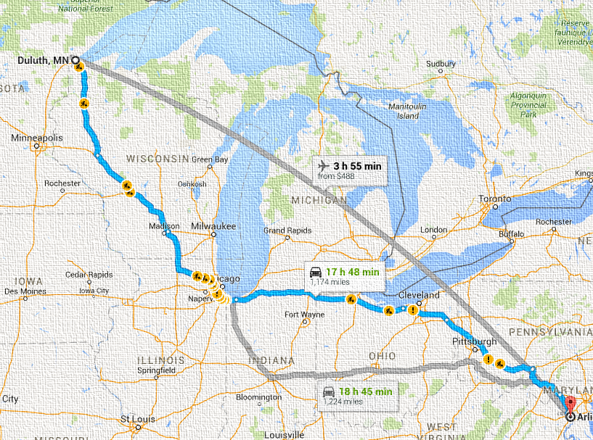
Principles of AOP Development
3. AOPs are a pragmatic unit of development and evaluation
Aromatase
Inhibition
Granulosa
Reduced E2 synthesis
Plasma
Reduced circulating E2
Hepatocyte
Reduced VTG production
Ovary
Impaired Oocyte Dev.
Female
Decreased ovulation/spawn
Population
Declining Trajectory
By convention AOP consists of a single sequence of key events connecting an MIE to AO (no branches)
AOP is a pragmatic simplification of complex biology
For a “pure ligand” – functional unit of prediction
One set of directions from point A to point B, not the map of all possible routes

Slide 9
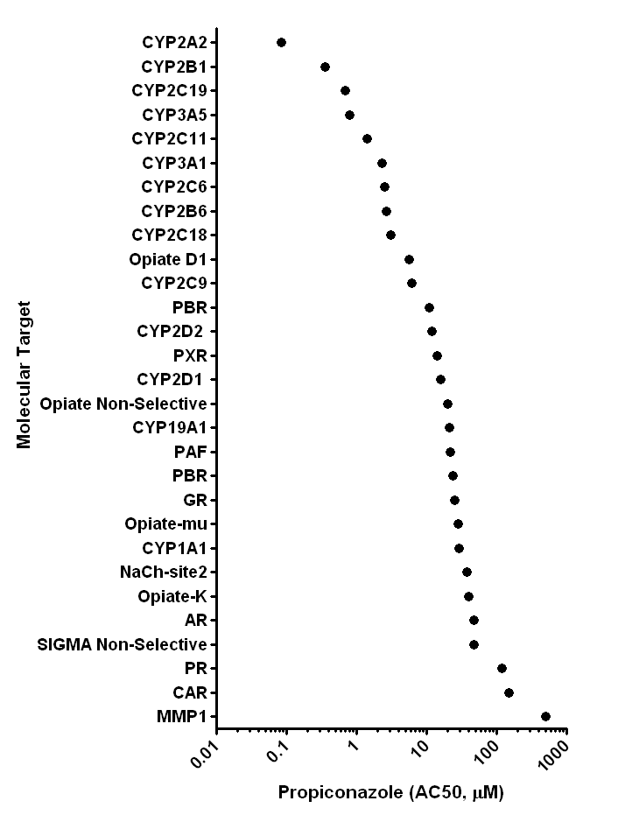
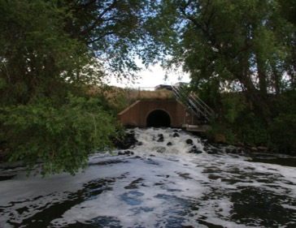
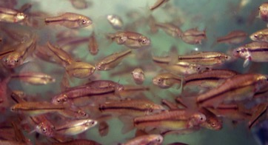
Principles of AOP Development
4. For most real-world applications, AOP networks are the functional unit of prediction
Chemicals with multiple biological activities
Exposure to multiple chemicals
Diuron
Imidacloprid
Linuron
Terbuthylazine
2,4-D
MCPP
Propachlor ESA
Butalbital
Diclofenac
Furosemide
Gemfibrozil
Ibuprofen
Naproxen
Phenobarbital
Phenytoin
Sulfamethoxazole
Triclosan
Acebutolol
Albuterol
Amitriptyline
AOPs are not triggered in isolation. They interact.

Slide 10
Principles of AOP Development
4. For most real-world applications, AOP networks are the functional unit of prediction
Key events shared by multiple AOPs
KERs shared by multiple AOPs
AR
Agonism
Hypothalamic Neurons
(-) Feedback
Theca/
Granulosa
Reduced T & E2 synthesis
Plasma
Reduced circulating E2
Hepatocyte
Reduced VTG production
Ovary
Impaired Oocyte Dev.
Female
Decreased ovulation/spawning
Population
Declining Trajectory
Aromatase
Inhibition
Granulosa
Reduced E2 synthesis
Plasma
Reduced circulating E2
Hepatocyte
Reduced VTG production
Ovary
Impaired Oocyte Dev.
Female
Decreased ovulation/spawning
Population
Declining Trajectory
CYP17, CYP11A
Inhibition
Theca/Granulosa
Reduced T & E2 Synthesis
Plasma
Reduced circulating E2
Hepatocyte
Reduced VTG production
Ovary
Impaired Oocyte Dev.
Female
Decreased ovulation/spawning
Population
Declining Trajectory
ER
Antagonism
Hepatocyte
Reduced VTG production
Ovary
Impaired Oocyte Dev.
Female
Decreased ovulation/spawning
Population
Declining Trajectory

Slide 11
Principles of AOP Development
4. For most real-world applications, AOP networks are the functional unit of prediction
AR
Agonism
Hypothalamic Neurons
(-) Feedback
Aromatase
Inhibition
Granulosa
Reduced E2 synthesis
Plasma
Reduced circulating E2
Hepatocyte
Reduced VTG production
Ovary
Impaired Oocyte Dev.
Female
Decreased ovulation/spawning
Population
Declining Trajectory
By building modular AOPs, we gradually describe the complexity of potential interactions.
AOPs meet systems biology
CYP17, CYP11A
Inhibition
ER
Antagonism

Slide 12
Principles of AOP Development
5. AOPs are living documents
AOPs are a way of organizing existing knowledge
As methods for observing biology evolve:
  New possibilities for KEs
  Ability to measure KEs with greater precision/accuracy
As new experiments are published:
  Weight of evidence supporting (or rejecting) KERs grows
  New AOPs and new branches in AOP networks discovered
There is no objective “complete AOP”

Slide 13
Principles of AOP Development
5. AOPs are living documents
Operationally-defined “stages” of AOP development
Stages of AOP Development | Characteristics
Putative AOPs: | Hypothesized set of KEs and KERs primarily supported by biological plausibility and/or statistical inference
Formal AOPs: | Include assembly and evaluation of the supporting weight of evidence – developed in AOP knowledgebase in accordance with internationally-harmonized OECD guidance
Quantitative AOPs: | Supported by quantitative relationships and/or computational models that allow quantitative translation of key event measurements into predicted probability or severity of adverse outcome
Increasing
Depth of evidence /understanding
Transparency /defensibility
Quantitative precision
Cost
Data needs
Time
All stages have potential utility
Level of development desired/required depends on the application

Slide 14
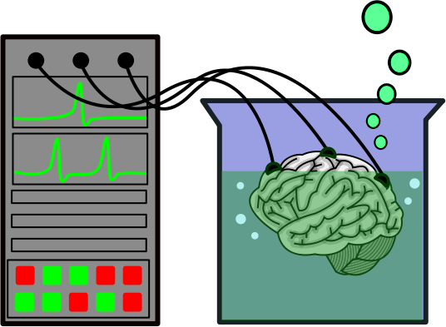
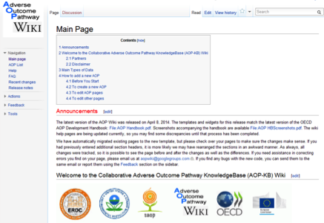
Transferrable Knowledge
Needs from a user standpoint:
  Systematically organized
  Transparent, well documented
  Scientifically-defensible, credible
  Accessible and searchable
  Integration and analysis
Needs from a developer standpoint:
  Collaboration / crowd-sourcing
  Avoiding duplicative effort
Users’ handbook supplement to OECD guidance document for developing and assessing AOPs.

Slide 15
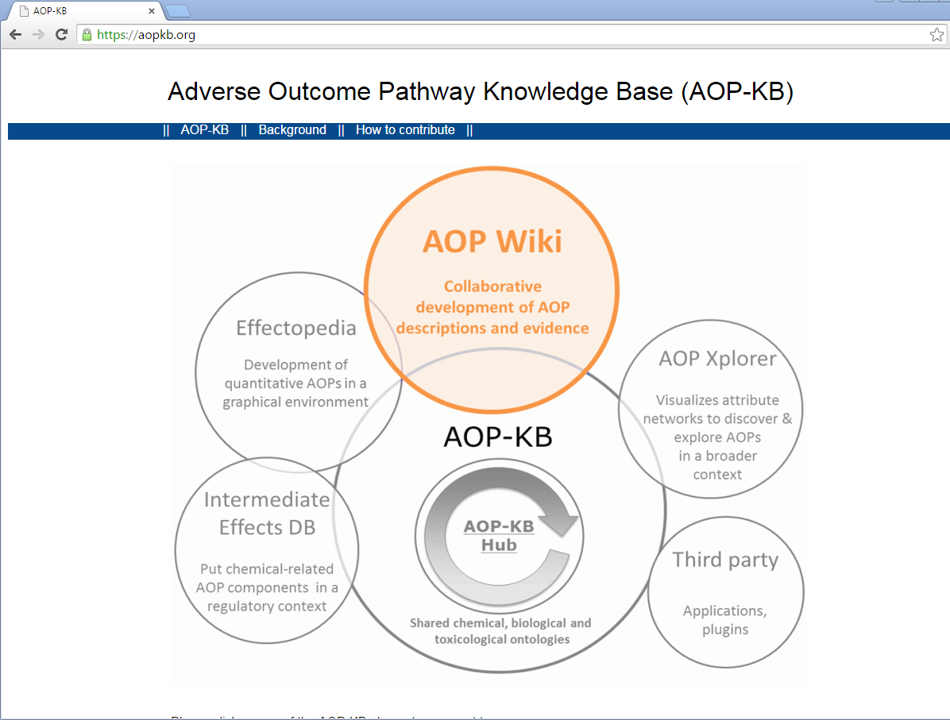
https://aopkb.org/
AOP-Wiki publically accessible since September, 2014
Other modules and tools under development

Slide 16
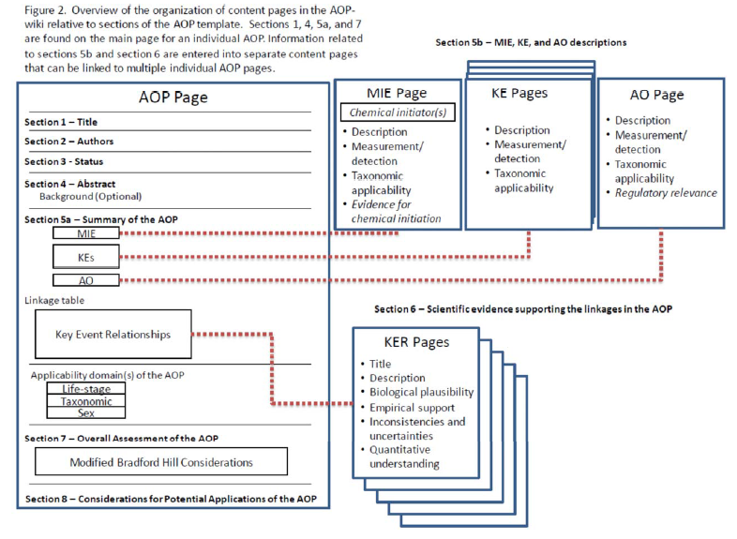
Modular organization.
Allows independent KE, KER pages to be linked to multiple AOPs.
Page contents align with sections of the “User’s Handbook”

Slide 17
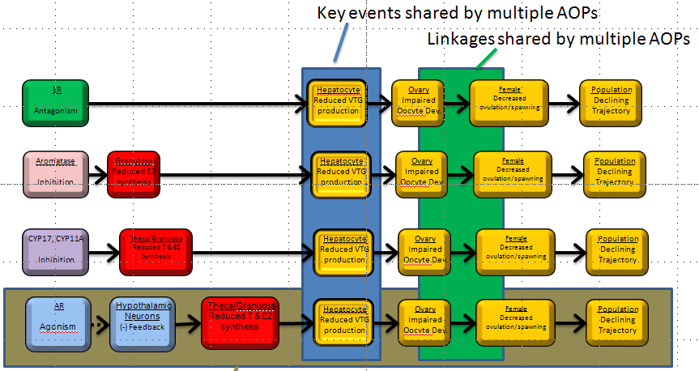


AOP-KB supports principles of AOP development
AOPs are modular
  KEs and KERs are shared by multiple AOPs
  No need to re-write the same descriptions over and over
  Reusability (best practices)
AOPs are living documents
  KE and KER descriptions can be expected to evolve over time
  As descriptions are updated and expanded – all AOP descriptions they link to update automatically
AOP networks for prediction
  Entry of structured information in KB allows for de-facto assembly of AOP networks.

Slide 18
Challenges

Slide 19
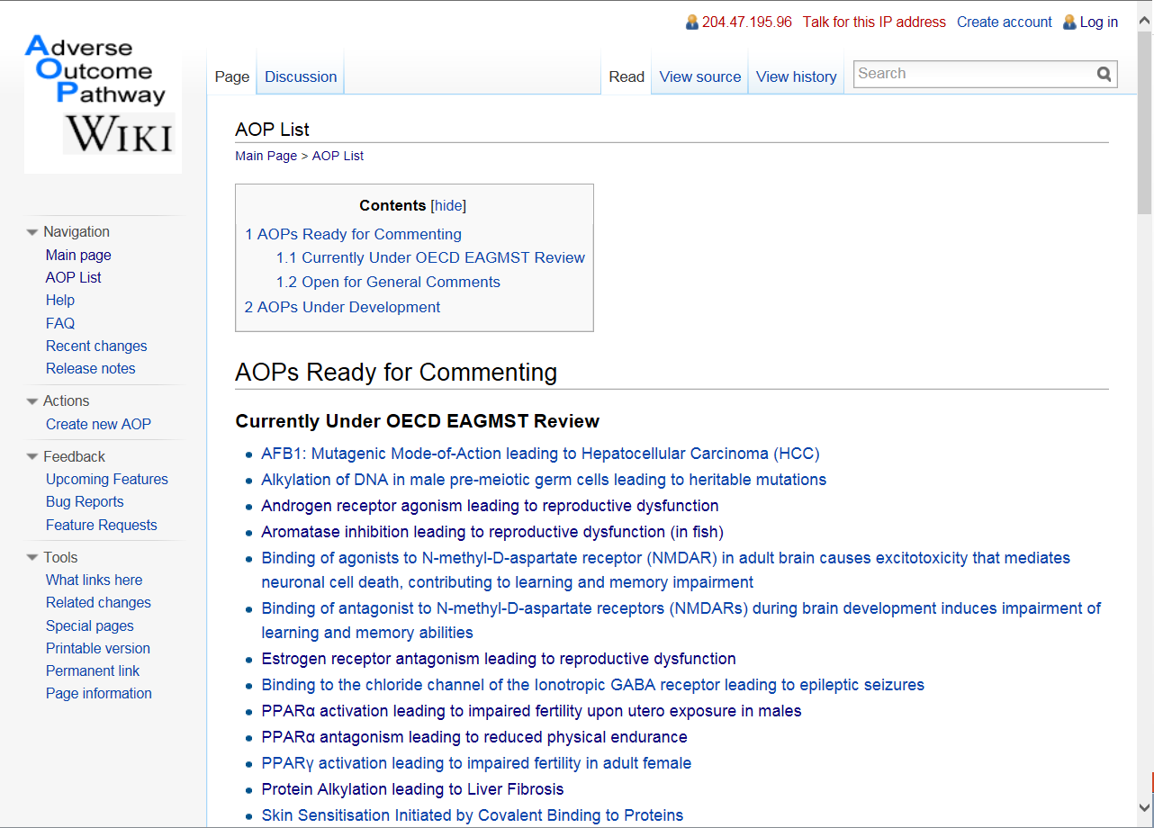
Expanding the KB
As of Oct. 20, 2015
113 AOPs
14 under review
17 open for comment

Slide 20
Expanding the KB
Other
1% - Respiratory
Kidney
Immune
Metabolic/ Energy
Muscle
Heart/ Vascular

Slide 21
Expanding the KB
26
23
ToxCast MIE
Other MIE
15
23
ToxCast KE
Other KE
3
ToxCast N/A KE

Slide 22




OECD AOP Development Project 1.29
A catalog of putative AOPs that will enhance the utility of US EPA ToxCast high throughput screening data for hazard identification
Focused on breadth, not depth
Hypothesized set of KEs and KERs primarily supported by biological plausibility and/or statistical inference
A set of “skeleton” KE and KER pages on which the community could build
  To the extent possible coordinating KE naming
  Build some preliminary AOP networks with which to test AOP network visualization and analysis approaches.

Slide 23

Vocabulary: A current challenge in AOP creation
Very difficult to create a controlled vocabulary that can accommodate the diversity of potential KE, KERs that could be included in an AOP.
Lack of standardized naming and ontologies for genes, proteins, pathways, etc. particularly across fields and for different taxa.
Many terms that mean the same thing, or perhaps slightly different things to different people.
Even slight variants in title can lead to creation of separate pages for the same event
  Steroid concentrations, reduced vs. steroid concentrations, decreased
  reproduction, impaired vs. reproductive dysfunction, induced
Use existing KEs & KERs to create your AOP whenever possible

Slide 24



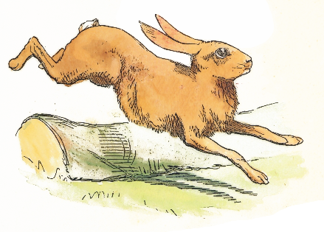
Incentivizing AOP development
Award for Adverse Outcome Pathway Development for New Contributors to the AOP Wiki
http://www.piscltd.org.uk/aop-prize/

Slide 25
Fit for purpose for different applications is dictated by level of confidence in pathway-based inference.
  WOE evaluation essential to bridge the research/regulatory interface
Prediction/extrapolation uncertainties
Screening and prioritization
Informed approaches to testing and assessment
Quantitative risk assessment (low tier, low impact)
Quantitative risk assessment (high tier, high impact)

Slide 26

To date, few studies are specifically designed for the purpose of AOP development
Consideration | Description
Dose-response concordance | Dose/concentrations needed to evoke change in Ke_{up} should be less than or equal to that needed to evoke Ke_{down.}
Temporal concordance | Observation of KE_{up} should precede observation of KE_{down} following administration of a stressor
Incidence concordance | KE_{up} should be observed as frequently, if not more frequently, than KE_{down}.
Often comparing a “dog’s breakfast” of different studies.
  Routes of exposure
  Dose selection
  Endpoints measured
  Time at which measurements taken
  Different replication/statistical power

Slide 27
Better understanding of the types of evidence that support AOPs can lead to design of experiments better suited for WOE evaluation
Strongest independent evidence
Plausibility
Essentiality
Empirical support (including quantitative understanding)
  Dose-response concordance
  Temporal concordance
  Incidence concordance
Weakest independent evidence

Slide 28
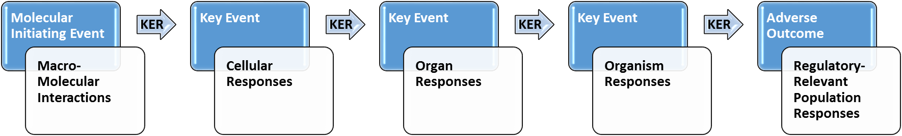

Moving from development to predictive application
Mode of Action
Adverse Outcome Pathway
Exposure
Target tissue
Chemical ADME
As soon as apply an AOP to chemical-specific prediction, need to consider ADME, chemical properties.
Absorption, Distribution, Metabolism, Excretion

Slide 29
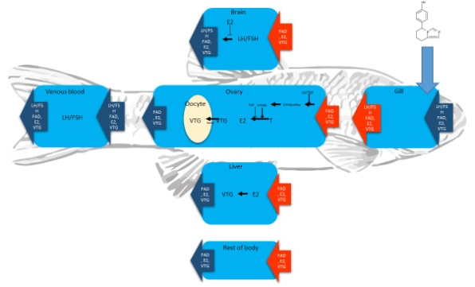
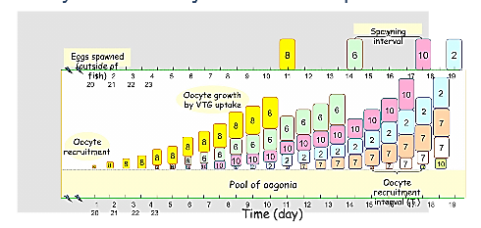
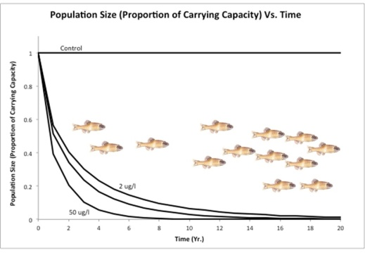
Moving from development to predictive application
HPG axis model
Aromatase
Inhibition
Granulosa
Reduced E2 synthesis
Plasma
Reduced circulating E2
Hepatocyte
Reduced VTG production
Plasma
Reduced circulating VTG
Oocyte growth dynamics model
Ovary
Impaired Oocyte Dev.
Female
Decreased ovulation/spawning
Population dynamics model
Population
Declining Trajectory

Slide 30
Development and dissemination of core principles of AOP development and global access to the AOP-KB are major advances over the last two years.
Outreach and education regarding the framework is addressing critical challenges
  Promoting connectivity within the KB
  Promoting engagement by broader community
  Design of studies tailored for AOP development
Ongoing research and development
  Aligning predictive models with AOPs
  Tools and approaches for AOP network analysis.

Slide 31


Adverse Outcome Pathway Discovery and Development
Haselman, Jon
Hazari, Medhi
Herr, David
Hester, Susan
Hotchkiss, Michelle
Hornung, Michael
Hughes, Michael
Hunter, Sid
Jayaraman, Saro
Jensen, Karl
Jensen, Kathleen
Judson, Richard
Kahl, Michael
Kenyon, Elaina
Klinefelter, Gary
Kodavanti, Prasada Rao
Korte, Joe
Kosian, Pat
Kostich, Mitch
Lake, April
Lambright, Christy
Lasat, Mitch
Laws, Susan
Lyke, Danielle
McQueen, Charlene
Miller, David H.
Mills, Lesley
Mills, Marc
Moore, Tanya
Mortensen, Holly
Moser, Ginger
Murr, Ashley
Nelson, Gail
Pleil, Joachim
Rosen, Mitch
Ross, Jeff
See, MJ
Sey, Yusupha
Simmons, Jane Ellen
Skelton, David
Stoker, Tammy
Strader, Lilly
Suarez, Juan
Tan, Cecilia
Teng, Quincy
Tennant, Alan
VanDuyn, Natalia
VanEmon, Jeanette
Villeneuve, Dan
Wang, Rong-Lin
Ward, William
Welch, Jeff
Wilson, Vickie
Wood, Charles
Project Lead Contact:
Villeneuve.dan@epa.gov
Edwards.stephen@epa.gov
Adams, Linda
Ankley, Gerald
Bencic, David
Biales, Adam
Borsay, Doranne
Buckalew, Angela
Bruon, Maribel
Cardon, Mary
Carswell, Gleta
Chorley, Brian
Collette, Tim
Conolly, Rory
Corton, Chris
Degitz, Sigmund
Dreher, Kevin
Edwards, Stephen
Ekman, Drew
El-Masri, Hisham
Evans, Nicola
Flick, Robert
Furr, Johnathan
Gilbert, Mary E.
Gordon, Denise
Gray, Leon
Hallinger, Daniel
Hartig, Phil
National Program Director: Tina Bahadori
Deputy NPD: Elaine Cohen Hubal
NHEERL MI: Joseph Tietge
NERL MI: John Kenneke
NCCT MI: John Cowden

